Slide 1



EEC 623 – SOFTWARE QUALITY ASSURANCE
PYTHON OPEN CV

Slide 2




OUR TEAM
Madhu Prakash Behara
Ajay motharapu
Sai Rohith Avula
2845381
2861616
2837016

Slide 3
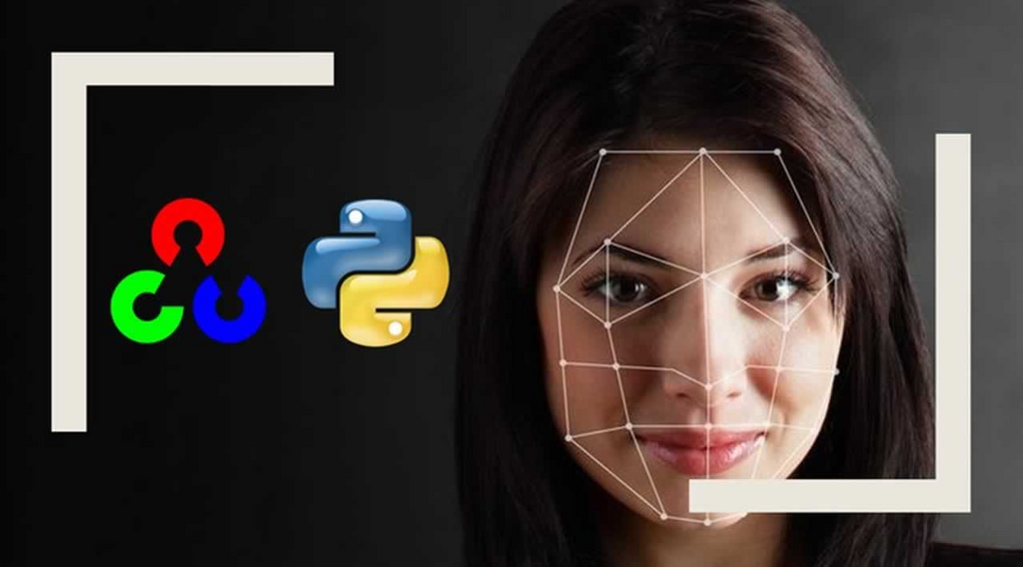
ABOUT OPEN CV
OPENCV (OPEN SOURCE COMPUTER VISION LIBRARY) IS A POWERFUL OPEN-SOURCE COMPUTER VISION AND MACHINE LEARNING SOFTWARE LIBRARY DESIGNED FOR REAL-TIME APPLICATIONS. IT WAS INITIALLY DEVELOPED BY INTEL IN 1999 AND IS NOW MAINTAINED BY A GROUP OF CONTRIBUTORS WORLDWIDE.

Slide 4

LANGUAGE
OpenCV is written primarily in C++, but it also has interfaces for other programming languages such as Python, Java, and MATLAB.
PLATFORM
OpenCV can run on multiple platforms, including Windows, Linux, macOS, Android, and iOS. It is also compatible with a range of hardware platforms, including desktops, servers, embedded systems, and mobile devices.

Slide 5
LIST OF FEATURES NOT TESTED
User interface design and usability
System performance and scalability under heavy load
Integration with other software systems or libraries
Security and data privacy features

Slide 6

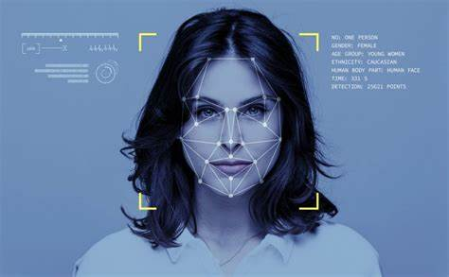
KEY FEATURE OF OPEN CV
OpenCV provides a wide range of computer vision functions and algorithms that can be used for tasks such as image and video processing, object detection, recognition, and tracking, and much more. It is written in C++, but it also has interfaces for other programming languages, such as Python.
Image processing: various functions such as filtering, edge detection, thresholding, and more.
Object detection and recognition: OpenCV has a built-in object detection and recognition framework that includes pre-trained models for detecting objects such as faces, pedestrians, and vehicles.
Machine learning: algorithms such as support vector machines (SVM), k-nearest neighbors (k-NN), and random forests, which can be used for tasks such as classification and regression.
Real-time performance: OpenCV is designed to be fast and efficient, making it ideal for real-time applications such as video processing and tracking.

Slide 7

LIST OF FEATURES THAT ARE TESTED
01
02
03
04
IMAGE FILTERING AND PROCESSING ALGORITHMS
FACIAL RECOGNITION AND TRACKING ALGORITHMS
VIDEO ANALYSIS AND PROCESSING ALGORITHMS
OBJECT DETECTION AND TRACKING ALGORITHMS

Slide 8

TEST CASES
Convert each frame to grayscale using cv2.cvtColor() Apply face detection using cv2.CascadeClassifier() Verify that at least one face is detected in each frame using the assert statement
Apply face detection using cv2.CascadeClassifier() Verify that at least one face is detected using the assert statement
Apply face detection using cv2.CascadeClassifier() Verify that multiple faces are detected using the assert statement.
TC001:
FACE DETECTION
TC 003
FACE DETECTION ON THE VIDEO STREAM
TC 002 MULTIPLE FACE DETECTION

Slide 9
TEST CASES
Apply face detection using cv2.CascadeClassifier() Verify that no faces are detected using assert statement Output Specifications: No faces are detected in the image
Verify that the object is correctly tracked using an assert statement and visual inspection Output Specifications: The object should be tracked accurately throughout the video
Verify that the filtered image is not identical to the original image using the assert statement Output Specifications: The filtered image should show a noticeable difference from the original image
TC004:
FALSE POSITIVE DETECTION
TC 006:
OBJECT TRACKING
TC 005: IMAGE FILTERING

Slide 10
CODE COVERAGE FOR TESTING
200
150
100
50
0
TC001
TC002
TC003
TC004
TC005
TC006
TC007

Slide 11
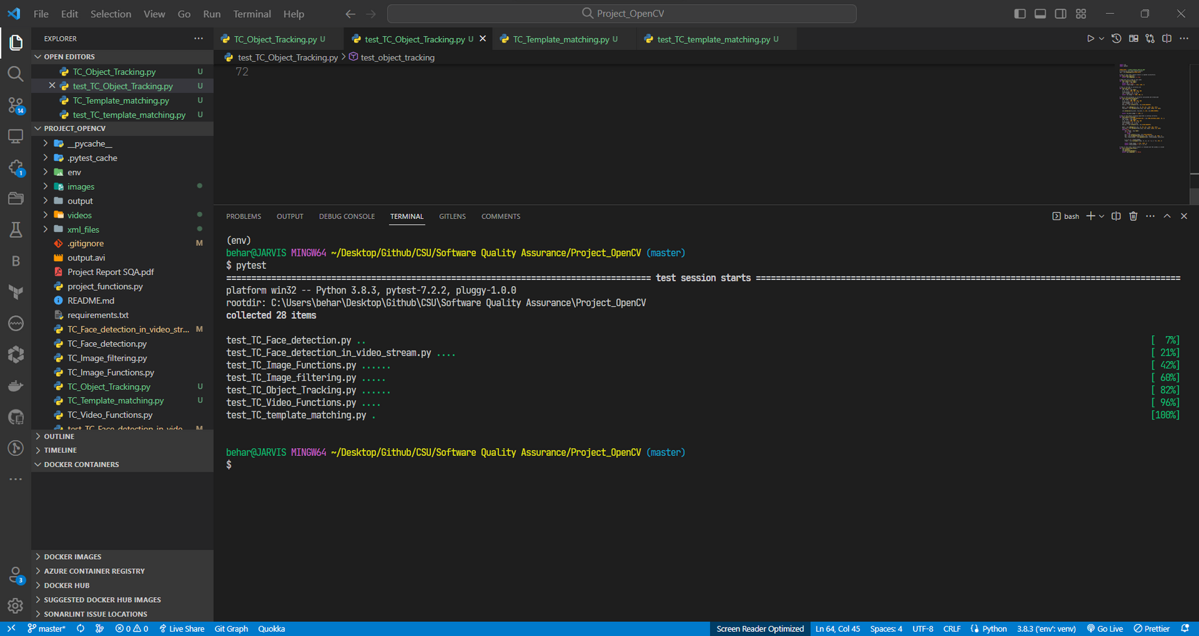
TESTING OUTPUT

Slide 12
SUMMARY
In summary, OpenCV is a powerful computer vision library that provides a wide range of functions and algorithms for image and video processing, object detection and recognition, machine learning, and much more. It's an essential tool for anyone working in the field of computer vision or machine learning.
As of my knowledge cutoff date of September 2021, OpenCV has over 47,000 stars on GitHub and has been forked over 25,000 times.

Slide 13

THANK'S FOR WATCHING

